Slide 1



AI & LLM with
2024 Summer Workshop
Dr. Timothy D.
Bowman "Dr. B"
Timothy D Bowman, PhD (Tim or Dr B) he/him/his
Associate Professor, The iSchool
tbowman@dom.edu
Phone: (708) 524-6653
Office Room: Crown 324,
7900 Division Street,
River Forest, IL 60305

Slide 2
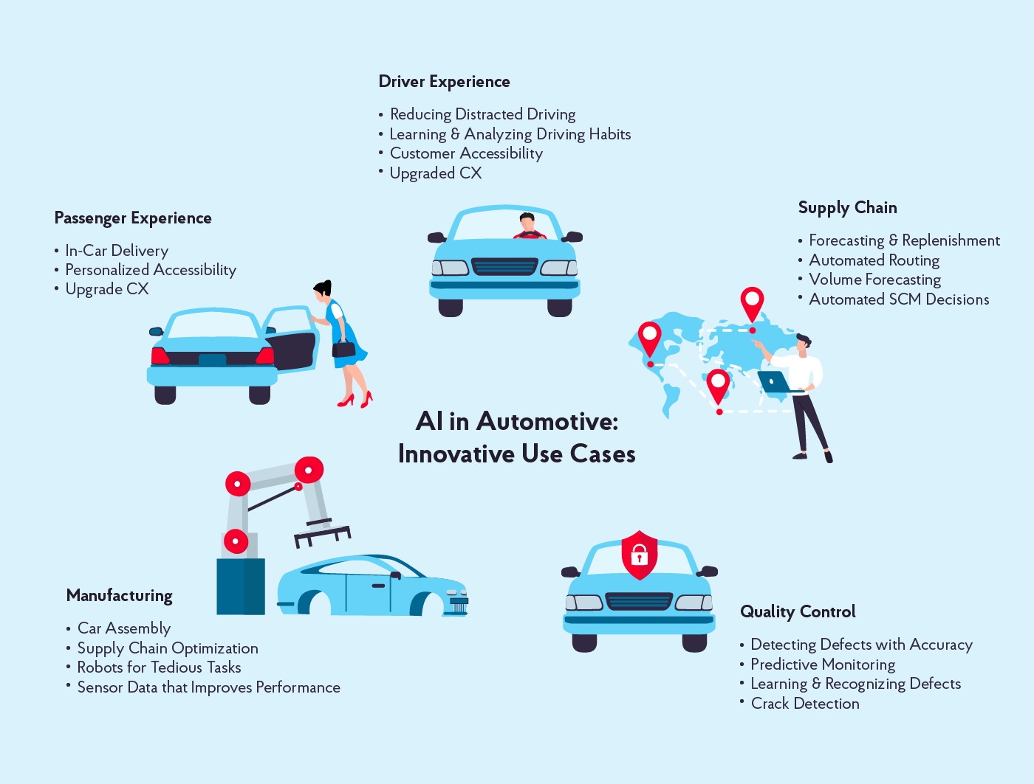
Artificial Intelligence and Autonomous Systems
Perception: AI can process data from sensors to understand environment;
Decision-Making: AI can make decisions based on processed information to solve complex problems
Learning: AI can improve over time; change can result in more sophisticated autonomous behavior
Predictive Analysis: AI can predict outcomes based on historical data
Adaptability: AI enables systems to adapt to new/changing environments; reinforcement learning enhances adaptability
https://nix-united.com/blog/ai-in-automotive-a-new-edge-of-the-automotive-industry/

Slide 3
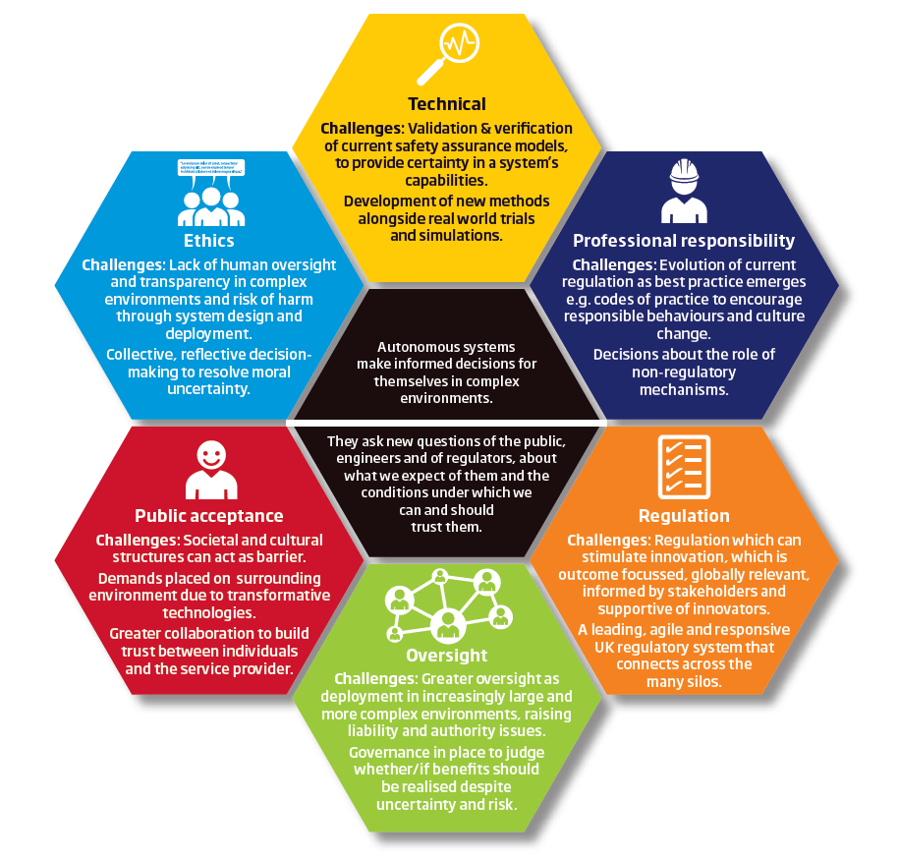
Challenges for Autonomous System
https://www.themanufacturer.com/articles/challenges-development-autonomous-systems/
Technical – new validation and verification methods are required alongside simulation and real-world trials to be able to assure the safety and certainty of a system’s capabilities.
Professional responsibility –the right standards and codes of practice are needed to drive culture change in light of new challenges posed by autonomous systems, and these must evolve as best practice emerges.
Regulation – where regulation is required to enforce standards should be carefully considered. A leading, agile and responsive UK regulatory system that can connect across the regulators of many sectors is required as autonomous systems become more widespread.
Oversight – as autonomous systems are deployed in increasingly large and more complex environments there will be liability and authority issues. There needs to be governance in place to judge if the uncertainty and risk a system creates justifies the benefits it brings.
Public acceptance –There should be greater public involvement before new autonomous systems are deployed, to build trust between individuals and the service providers.
Ethics – There must be mechanisms in the design process that enable collective, re­flective, transparent decision-making to resolve uncertainty, address the lack of human oversight and inform how autonomous systems are deployed.

Slide 4
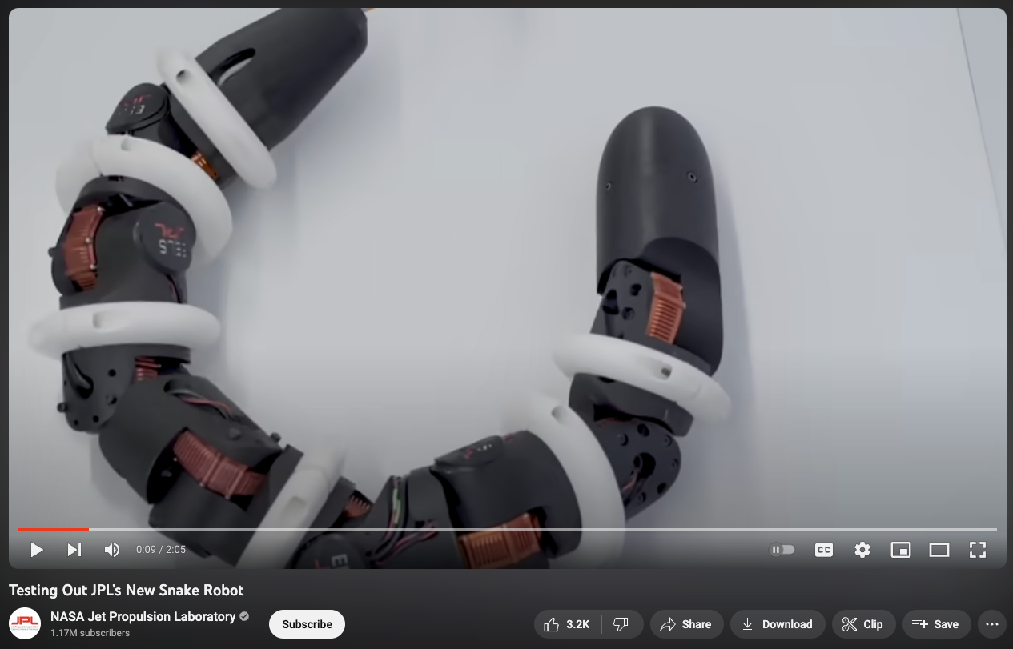
Testing Out JPL’s New Snake Robot
https://www.youtube.com/watch?v=ifCIDT4X9AM

Slide 5
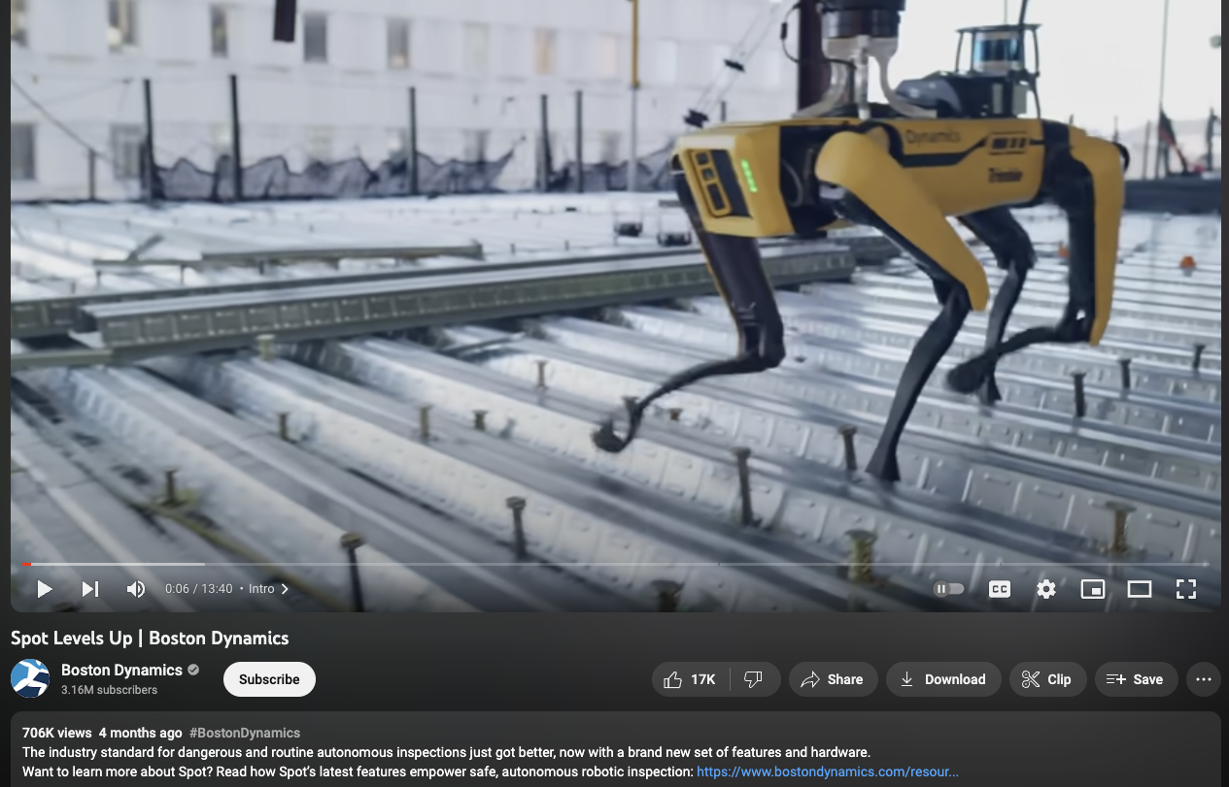
Spot Levels Up | Boston Dynamics
https://www.youtube.com/watch?v=qgHeCfMa39E

Slide 6
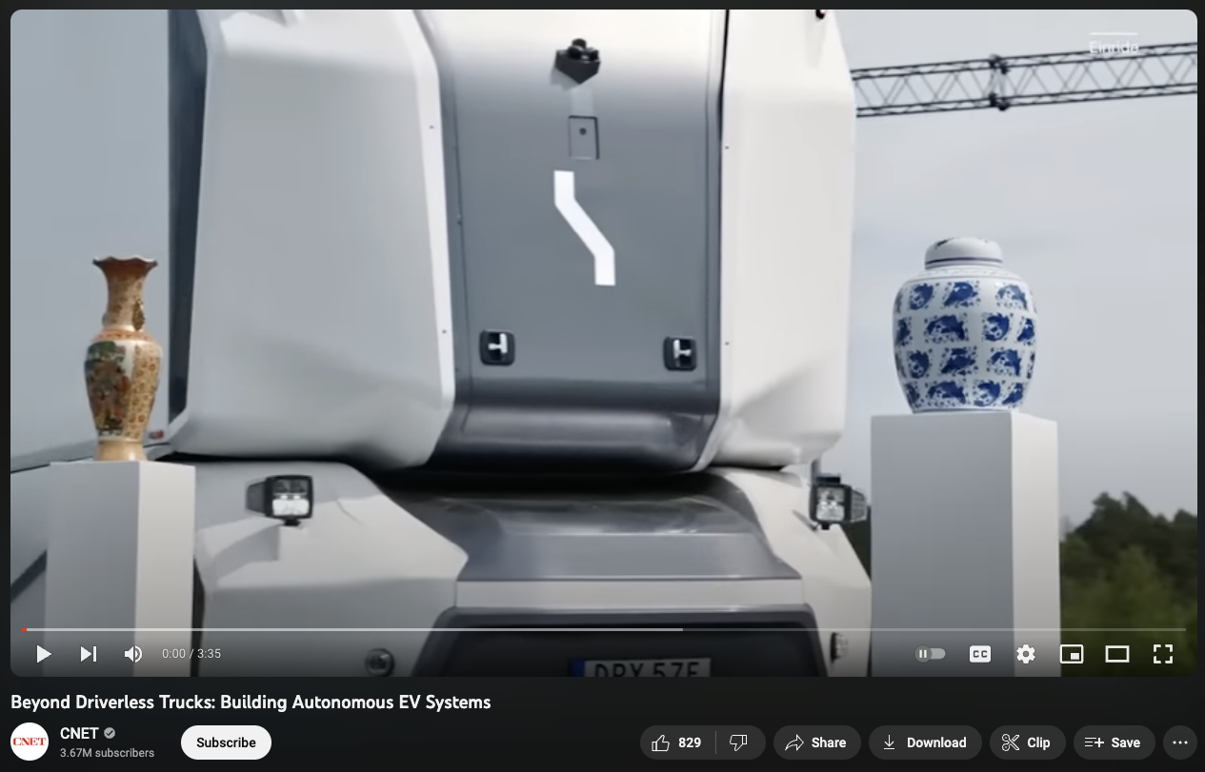
Beyond Driverless Trucks: Building Autonomous EV Systems
https://www.youtube.com/watch?v=j69mhky2S_4

Slide 7
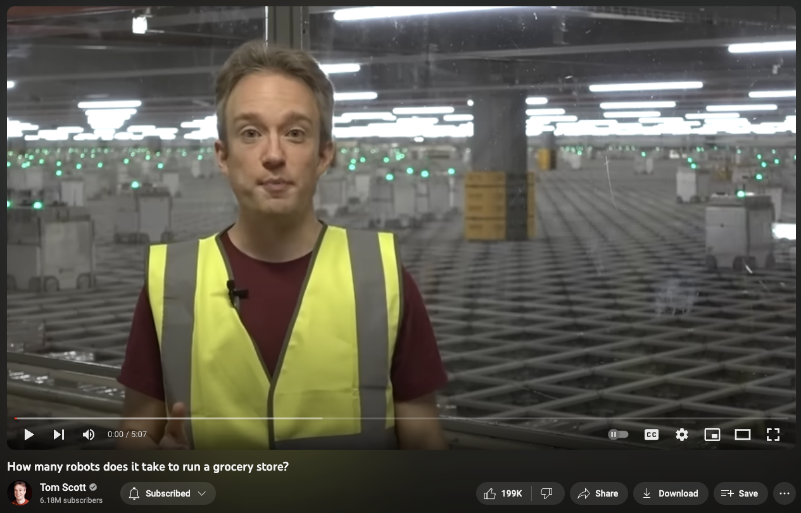
How many robots does it take to run a grocery store?
https://www.youtube.com/watch?v=ssZ_8cqfBlE

Slide 8
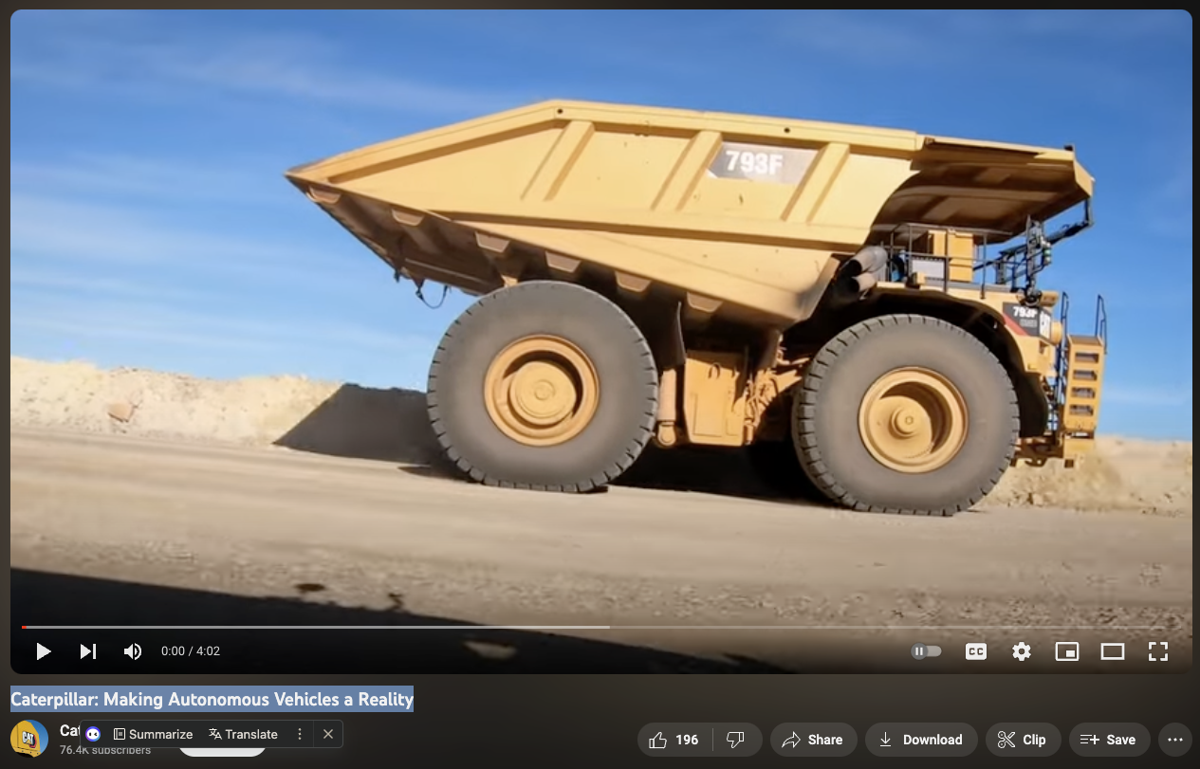
Caterpillar: Making Autonomous Vehicles a Reality
https://www.youtube.com/watch?v=QJGlh76YYpU

Slide 9
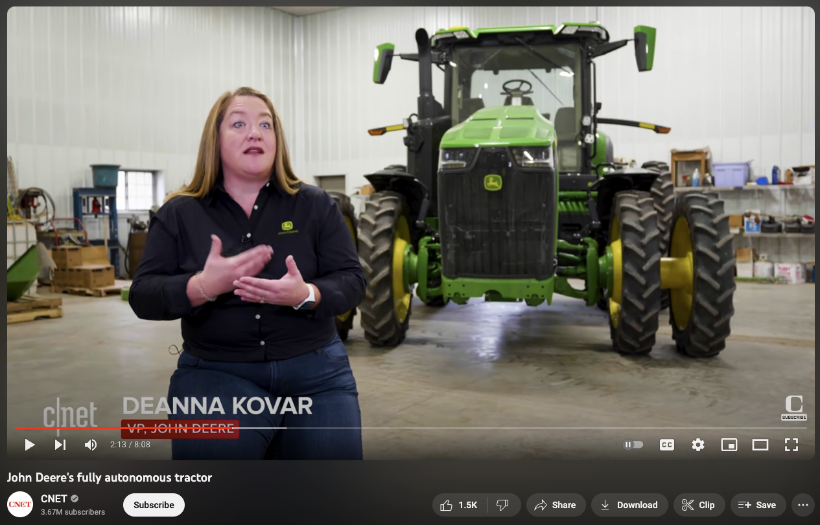
John Deere's fully autonomous tractor
https://www.youtube.com/watch?v=tSdIgGin_rk

Slide 10
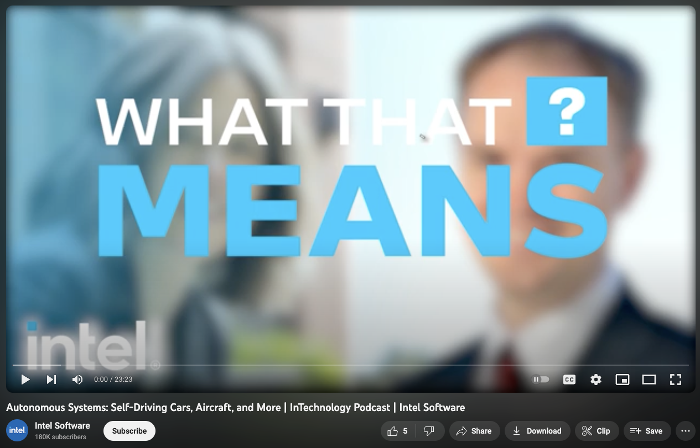
Autonomous Systems: Self-Driving Cars, Aircraft, and More | InTechnology Podcast | Intel Software
https://www.youtube.com/watch?v=Wn4iPcnyD0M

Slide 11
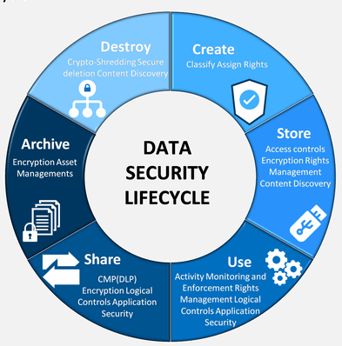
Security, Privacy, and Trust
Information Security: is the practice of protecting digital information from unauthorized access, corruption or theft throughout its entire lifecycle. It’s a concept that encompasses every aspect of information security from the physical security of hardware and storage devices to administrative and access controls, as well as the logical security of software applications. It also includes organizational policies and procedures.
https://www.ibm.com/topics/data-security
https://in.pinterest.com/pin/420945896429697881/

Slide 12
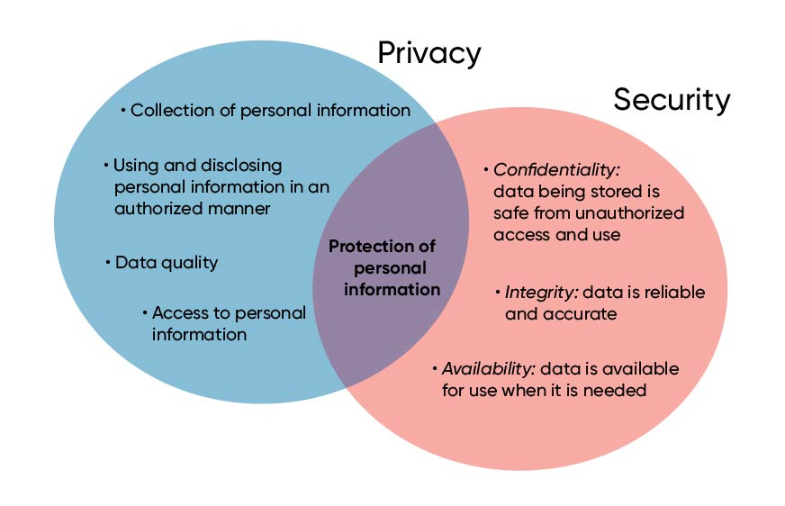
Security, Privacy, and Trust
Information Privacy: Broadly speaking, privacy is the right to be let alone, or freedom from interference or intrusion. Information privacy is the right to have some control over how your personal information is collected and used.
https://iapp.org/about/what-is-privacy/
Data privacy is focused on the use and governance of personal data—things like putting policies in place to ensure that consumers’ personal information is being collected, shared and used in appropriate ways.
Security focuses more on protecting data from malicious attacks and the exploitation of stolen data for profit. While security is necessary for protecting data, it’s not sufficient for addressing privacy.

Slide 13
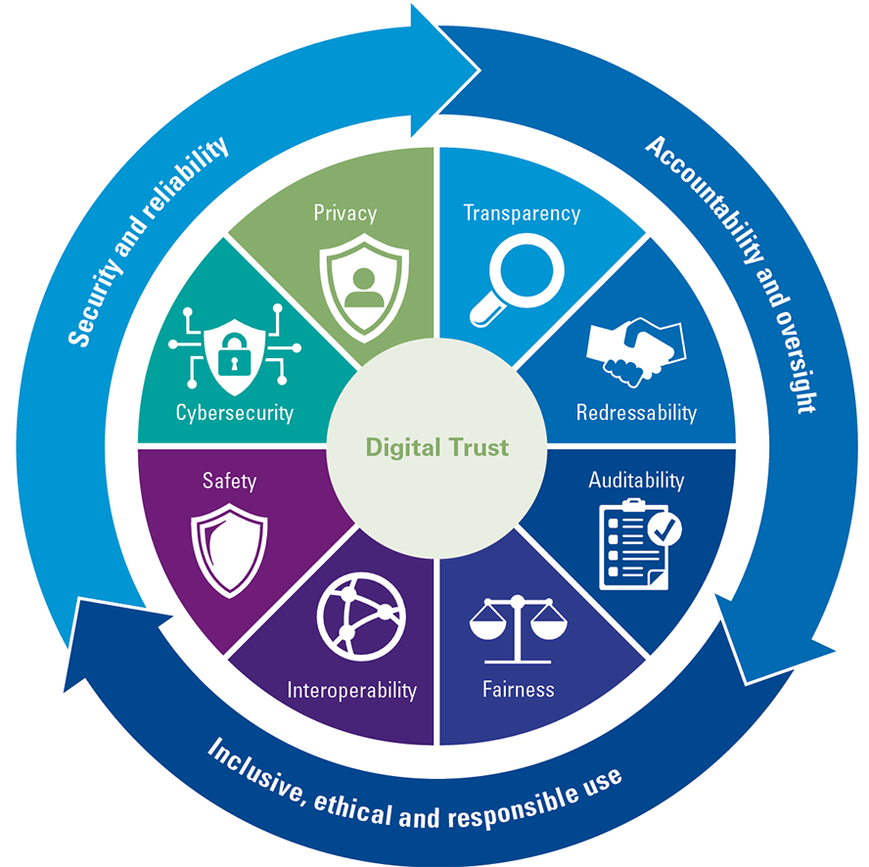
Security, Privacy, and Trust
Digital Trust: is at the intersection of privacy and security. Both concepts together lay a strong foundation for digital trust, along with other elements such as quality, availability, ethics and integrity, transparency and honesty, and resiliency.
https://www.compact.nl/en/articles/a-global-framework-for-digital-trust-kpmg-and-world-economic-forum-team-up-to-strengthen-digital-trust-globally/

Slide 14
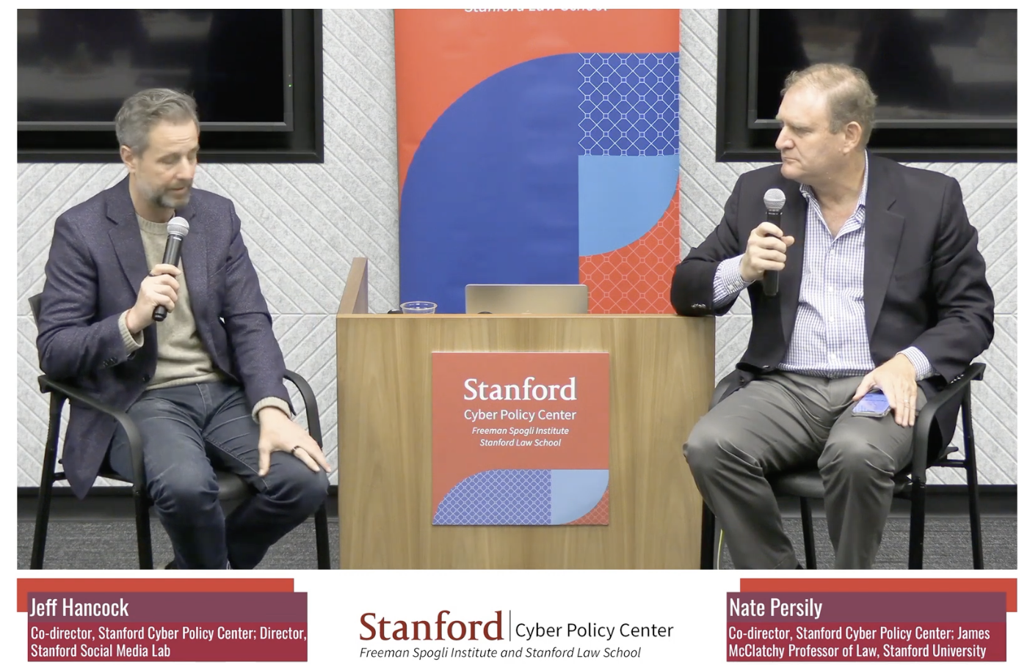
Generative AI and the End of Trust
A conversation with Jeff Hancock, co-director of the CPC and director of the Stanford Social Media Lab. The session will be moderated by Nate Persily. This session is part of the Spring Seminar Series, a series spanning April through June, hosted at the Cyber Policy Center with the Program on Democracy and the Internet.
The impact of recent AI advancements has massive implications for trust in human interactions. There is not only a growing role of AI in financial decision-making, risk assessment, and fraud detection, but the introduction of generative AI will challenge the maintenance of trust and accountability in an increasingly AI-mediated world. In this talk, Hancock will cover recent research on how people perceive and detect AI in human communication, and how generative AI is likely to undermine trust in several important human domains
https://www.youtube.com/watch?v=XUCUNvu8QUg

Slide 15
Brief History of AI
1995 – Wallace developed A.L.I.C.E. chatbot
1997 - IBM Deep Blue defeats Garry Kasparov, world chess champion
1998 - Brin & Page develop Google search algorithm incorporating AI techniques
1973 - Lighthill Report criticizes AI progress in UK
1979 - Stanford Cart navigates a room using computer vision
50s - Turing test
1956 - John McCarthy coins term "Artificial Intelligence"
60s
80s
00s
1965 - Weisenbaum creates ELIZA
1969 - Minsky & Papert publish "Perceptrons"
1980 - Expert systems mimic decision-making of human expert
1986 - Neural network research revitalized after Backpropagation algorithm introduced
2005 – DARPAs Grand Challenge an autonomous vehicle navigates 131-mile course
2009 – Google starts developing self-driving cars
50s
70s
90s

Slide 16
Brief History of AI (cont)
2020 - Microsoft releases T-NLG (LLM @ 17 billion parameters)
2020 – openAI relases GPT-3 LLM (10x greater than T-NLG) 2021 – openAI announces ChatGPT
2021 – openAI intoduces Dall-E
2022 – Stable Diffusion released
2022 – Midjourney released
2022 – openAI released chatGPT 3.5
2023 – Google Bard released
2023 – openAI released chatGPT 4 (1.7 trillion parameters)
2023 – Musk, Wozniak, and others sign petition
2023 – Statement of AI Risk released
2023 – US Senate holds "AI Insight Forum"
…… and we are taking off into the unknown….
2011 – IBM Watson wins Jeopardy! 2014 – Industry moves ahead of academia with learning models
2014 – Google aquires DeepMind
2014 – Alexa introduced
2015 – CNTK and TensorFlow released
2016 – Google AlphaGo defeats Go world champion
2018 – OpenAI releases GPT-2, large scale unsupervised LM
2010s
2020s

Slide 17
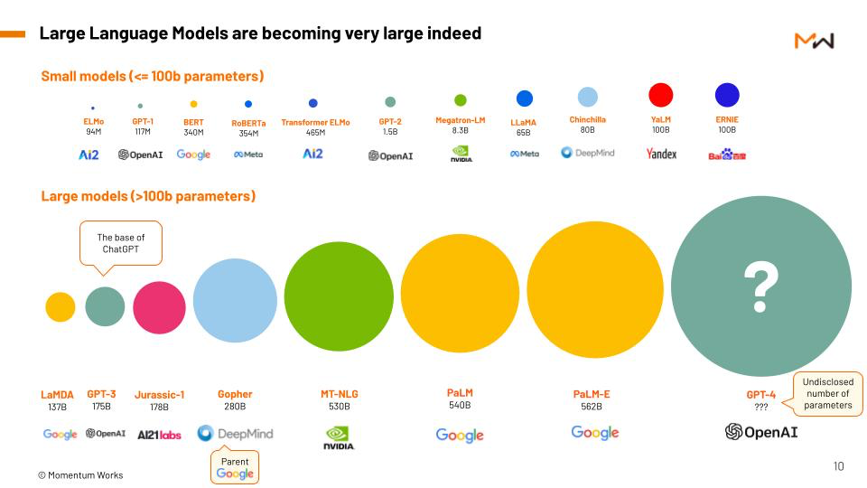
1.7 TRILLION!
https://momentum.asia/product/the-future-by-chatgpt/

Slide 18
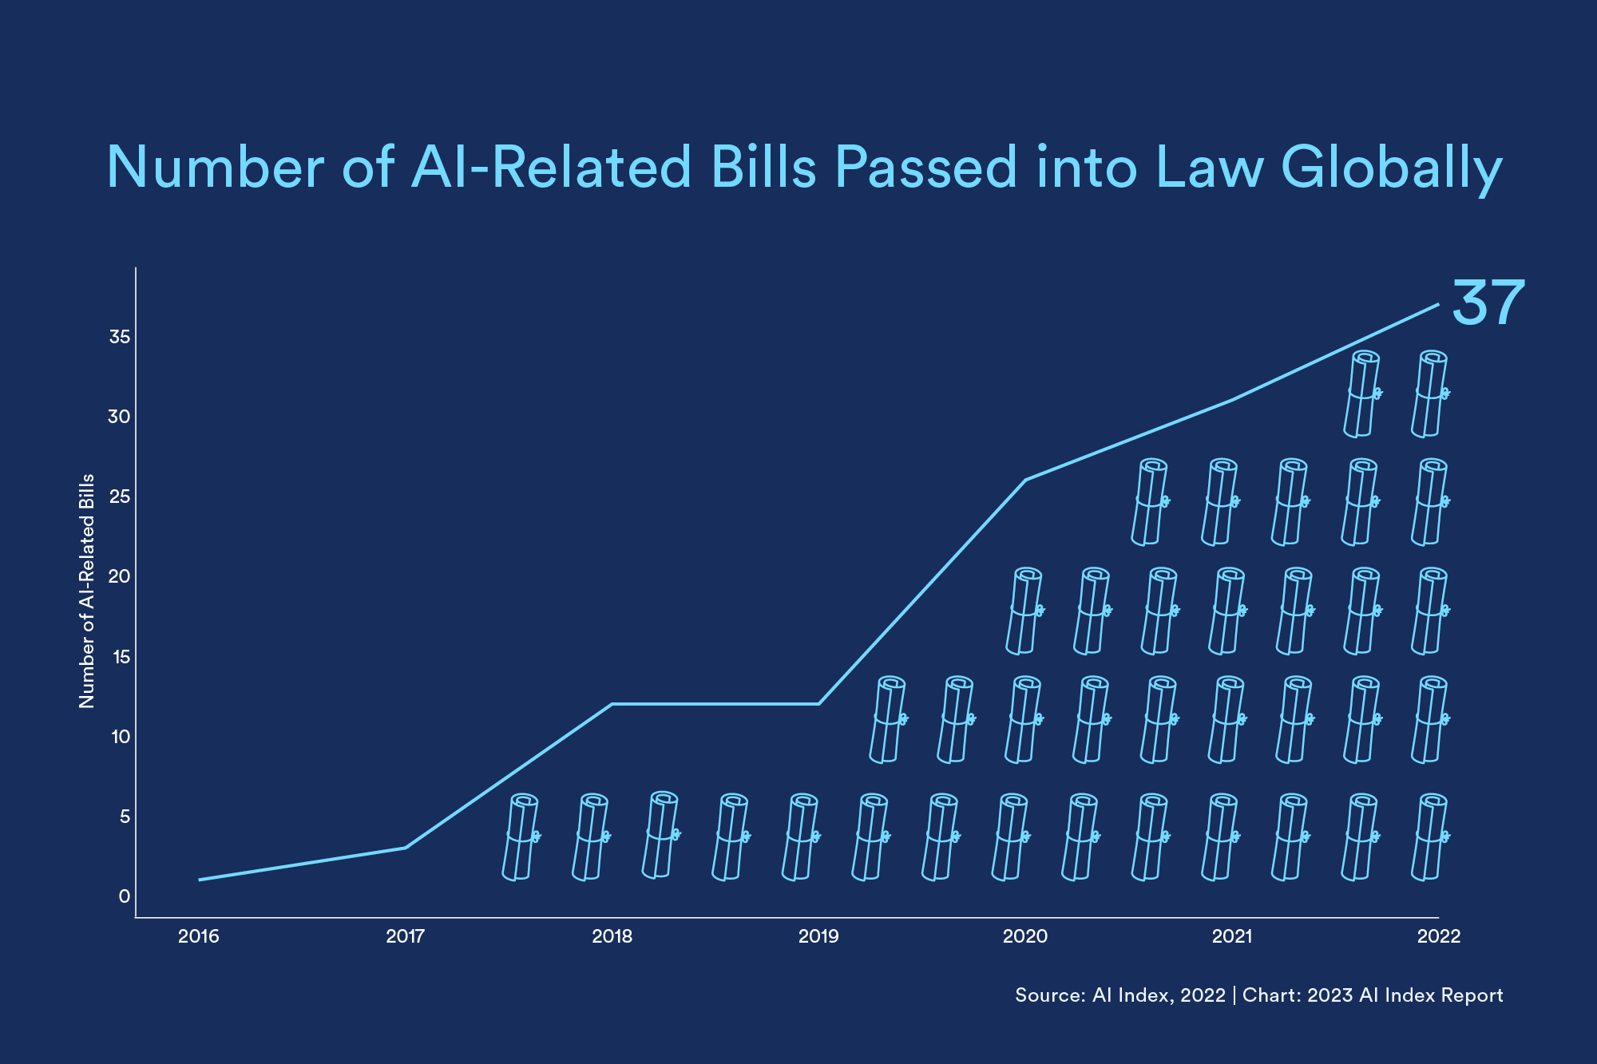
Legislative Concerns Globally
https://hai.stanford.edu/news/2023-state-ai-14-charts
EU Sets Rules Governing Use of AI (June 14, 2023) The E.U. Artificial Intelligence Act is likely to ban controversial uses of AI like social scoring and facial recognition in public, as well as force companies to declare if copyrighted material is used to train their AIs.
Biden-Harris Secure Voluntary Commitments from Leading AI Companies to Manage Risks Posed by AI https://www.whitehouse.gov/briefing-room/statements-releases/2023/07/21/fact-sheet-biden-harris-administration-secures-voluntary-commitments-from-leading-artificial-intelligence-companies-to-manage-the-risks-posed-by-ai/
Senate Majority Leader Chuck Schumer's forum on AI (Sept 13, 2023) More than 60 senators showed up to the closed-door briefing — with Musk, Bill Gates, Sundar Pichai, Mark Zuckerberg and Sam Altman among 20 tech and civil society leaders in the room.
Legislative bodies in 127 countries passed 37 laws that included the words “artificial intelligence” this past year. The U.S. led the list, passing nine laws, followed by Spain (5) and the Philippines (4).. Since 2016, countries have passed 123 AI-related bills, the majority in recent years.

Slide 19

Ethical Concerns Globally
Partnership on AI https://partnershiponai.org/ https://partnershiponai.org/partners/
News Media Alliance – Global Principles on Artificial Intelligence (AI) https://www.newsmediaalliance.org/global-principles-on-artificial-intelligence-ai/
Writers Guild of America Strike "One of their key demands is that the studios and streaming giants agree to limits on the future use of AI-powered writing tools, such as ChatGPT." -- https://www.bbc.com/news/business-66289583
Samsung SDS – AI Ethics and AI Governance – The Social Responsibility of AI https://www.samsungsds.com/en/insights/ai_governance.html
SalesChoice Fair AI Ethics Policy https://www.saleschoice.com/policy/
https://www.pcmag.com/news/ai-around-the-world-heres-how-different-countries-are-using-it

Slide 20
Bias in AI
Discrimination Through AI: To What Extent Libraries are Affected and how Staff can Find the Right Mindset
https://www.zbw-mediatalk.eu/2022/03/discrimination-through-ai-to-what-extent-libraries-are-affected-and-how-staff-can-find-the-right-mindset/
Machine Bias: There's software used across the country to predict future criminals. And it's biased against blacks.
https://www.propublica.org/article/machine-bias-risk-assessments-in-criminal-sentencing
Does AI Debias Recruitment? Race, Gender, and AI’s “Eradication of Difference”
https://link.springer.com/article/10.1007/s13347-022-00543-1
Gender Shades: Intersectional Accuracy Disparities in Commercial Gender Classification https://proceedings.mlr.press/v81/buolamwini18a/buolamwini18a.pdf
White Paper: Addressing Bias in Artificial Intelligence https://www.thomsonreuters.com/en-us/posts/wp-content/uploads/sites/20/2023/08/Addressing-Bias-in-AI-Report.pdf
We Can’t Ignore AI: Library workers tackle bias in AI and slow adoption of the technology https://americanlibrariesmagazine.org/blogs/the-scoop/we-cant-ignore-ai/ Bias, diversity, and challenges to fairness in classification and automated text analysis. From libraries to AI and back
https://doi.org/10.48550/arXiv.2303.07207
….
AI or machine learning bias is “a phenomenon that occurs when an algorithm produces results that are systemically prejudiced due to erroneous assumptions in the machine learning (ML) process.”

Slide 21
Name | URL
Althea | https://clarivate.com/products/books/alethea/ | Supercharge student engagement with course materials and academic texts
Anaconda AI Navigator | https://www.anaconda.com/products/ai-navigator | Anaconda’s newest desktop application gives you secure access to various large language models (LLMs) so you can find the best fit for your use cases.
Apple Intelligence | https://www.apple.com/apple-intelligence/ | AI for the rest of us
Ask R Discovery | https://discovery.researcher.life/ask-rdiscovery | AI-powered research tool that fetches fact-based answers validated from 250M+ research papers
Bit | https://bit.ai/ | Bit is here to redefine efficiency and teamwork! Imagine a world where organizations and individuals can effortlessly create, collaborate, and organize all their knowledge in a single, powerful, scalable platform, accessible from anywhere on the planet!
ChatGPT | https://chatgpt.com/auth/login | LLM Powered Chatbot/Image Generator
ChatGPT Edu | https://openai.com/index/introducing-chatgpt-edu/ | LLM Powered Chatbot/Image Generator for universities
ChatPDF | https://www.chatpdf.com/ | instantly answer questions and understand research with AI
Claude | https://claude.ai/login | LLM Powered Chatbot/Image Generator
Connected Papers | https://www.connectedpapers.com/ | Explore connected papers in a visual graph.
Consensus | https://consensus.app/ | AI search engine for research
Dimensions Research GPT | https://app.dimensions.ai/ | Users can get AI-generated answers to research-related questions on the GPT platform informed by Dimensions’ huge database, making ChatGPT more research-specific for topic exploration.
Elephas (Mac Only) | https://elephas.app/ | Your Personal AI Writing Assistant for Mac
Elicit | https://elicit.com/ | Automate time-consuming research tasks like summarizing papers, extracting data, and synthesizing your findings.
Explain Paper | https://www.explainpaper.com/ | Upload a paper, highlight confusing text, get an explanation. We make research papers easy to read.
Feedback Fruits | https://feedbackfruits.com/automated-feedback | Acai's Automated Feedback addresses mechanical and structural elements like citation, academic style, grammar, and structure, leaving teachers with more time to focus on higher-order cognitive skills like comprehension and critical argumentation of concepts.
Gamma | https://gamma.app/ | A new medium for presenting ideas. Powered by AI. Beautiful presentations, documents, and websites. No design or coding skills required.
Goblin Tools | https://goblin.tools/ | LLM Tools designed to help neurodivergent people with tasks they find overwhelming or difficult.
Google Gemini | https://gemini.google.com/ | A family of multimodal AI models that can understand and generate various forms of data, including text, images, and code, and is being integrated across Google's products
Grammarly | https://www.grammarly.com/ | Responsible AI that ensures your writing and reputation shine
Heuristicia | https://www.heuristi.ca/ | Learning & Research Made Simpler With AI
HeyGPT | https://heygpt.chat/ | Empower your ChatGPT experience
HuggingFace | https://huggingface.co/ | We are on a mission to democratize good machine learning, one com
Jenni | https://jenni.ai/ | Your Writing Assistant for Research
JSTOR Interative Research Tool | https://about.jstor.org/gen-ai/ | This tool empowers people to deepen and expand their research with JSTOR’s trusted corpus.
Keenious | https://keenious.com/ | Keenious is designed to help students, researchers, and librarians discover hard-to-find research articles
Kortext Premium | https://www.kortext.com/premium-live/ | A groundbreaking suite of next generation study tools designed to introduce generative AI to your teaching and learning processes.
Litmaps | https://www.litmaps.com/ | Litmaps uses the citation network to discover literature that's easily overlooked with other search methods

Slide 22
Name | URL
Litmaps | https://www.litmaps.com/ | Litmaps uses the citation network to discover literature that's easily overlooked with other search methods
LLama (Meta) | https://llama.meta.com/ | LLM Powered Chatbot/Image Generator
LLMArena | https://llmarena.ai/ | Select 2-10 LLMs to see a side-by-side comparison
Lumen Writer | https://lumenwriter.ai/ | Unleash the potential of our cutting-edge AI generated essay tool to elevate your papers to new heights.
Microsoft Azure OpenAI Service | https://azure.microsoft.com/en-us/products/ai-services/openai-service | Connect your own data, call functions, and improve workflow with language and image models
Microsoft Copilot | https://copilot.microsoft.com/ | AI companion that works everywhere you do and intelligently adapts to your needs.
Microsoft Copilot for Microsoft 365 | https://www.microsoft.com/en-us/microsoft-365/enterprise/copilot-for-microsoft-365 | Boost creativity and streamline your workday with AI assistance in even more Microsoft 365 apps.
Mistral AI | https://mistral.ai/ | Open AI Models and Developer Platform
NextNet | https://getnextnet.com/ | Our mission is to organize and integrate the world’s biomedical knowledge and make it accessible.
Open Read | https://www.openread.academy/ | Gain valuable insights from a vast repository of over 300 million papers spanning nearly every academic discipline, or tap into trillions of web sources for comprehensive research.
Packback | https://www.packback.co/ | Packback is a pedagogy partner that uses technology as a “means to an end” to shorten feedback loops for students and instructors, improve writing and critical thinking skills, and cultivate student-centered, trust-based educational learning environments.
PaperBrain | https://www.paperbrain.org/ | People publish a lot of fascinating research out to the world, yet the tools to consume this research are quite primitive. This is an interface optimized for exploration: please wander about topics and papers to your brain's content.
Paperpal | https://paperpal.com/homev2 | Overcome writer's block and fast-track your path to success with Paperpal's secure, trusted generative AI features
Papers | https://www.papersapp.com/ | Your centralized, smart reference library solution to dramatically improve the way you discover, organize, read, annotate, share, and cite your research.
Perplexity | https://www.perplexity.ai/ | Free AI search engine designed to revolutionize the way you discover information.
Personify | https://personifyai.app/ | A new way for instructors to use generative AI to provide their students with immediate, personalized feedback and a one-on-one tutoring experience.
Pi | https://pi.ai/ | The first emotionally intelligent AI
Poe | https://poe.com/ | The AI on Poe is powered by models from several sources, trained by different companies
PowerDrill | https://powerdrill.ai/ | AI for serious data work
ProQuest™ Research Assistant | https://about.proquest.com/en/blog/2024/proquest-part-of-clarivate-launches-ai-powered-research-assistant/ | Enabling students to use conversational inquiry to explore vast, vetted and authoritative content.
QuillBot | https://quillbot.com/ | We use AI to strengthen writing and boost productivity—without sacrificing authenticity.
ResearchRabbit | https://www.researchrabbit.ai/ | Uses artificial intelligence (AI) to help researchers discover publications and map literature citations
ScholarAI | https://scholarai.io/ | Trustworthy AI that enables scientists, researchers and lawyers to do their best work
Scispace Paraphraser | https://typeset.io/paraphraser | Make your academic writing clear and original.
Scite | https://scite.ai/ | Helps researchers better discover and understand research articles through Smart Citations–citations that display the context of the citation and describe whether the article provides supporting or contrasting evidence
Scopus AI | https://www.elsevier.com/products/scopus/scopus-ai | An intuitive and intelligent search tool powered by generative AI (GenAI) that enhances your understanding and enriches your insights with unprecedented speed and clarity.
SearchGPT | https://openai.com/index/searchgpt-prototype/ | New AI search features that give you fast and timely answers with clear and relevant sources.
Semantic Scholar | https://www.semanticscholar.org/ | Free, AI-powered research tool for scienctific literature
Talpa | https://www.talpasearch.com/ | Talpa combines cutting-edge technology with data from libraries, publishers and readers to enable entirely new ways of searching—and find what you're looking for.
Tavily | https://tavily.com/ | Tavily Search API is a search engine optimized for LLMs and RAG, aimed at efficient, quick, and persistent search results

Slide 23
Name | URL
Scite | https://scite.ai/ | Helps researchers better discover and understand research articles through Smart Citations–citations that display the context of the citation and describe whether the article provides supporting or contrasting evidence
Scopus AI | https://www.elsevier.com/products/scopus/scopus-ai | An intuitive and intelligent search tool powered by generative AI (GenAI) that enhances your understanding and enriches your insights with unprecedented speed and clarity.
SearchGPT | https://openai.com/index/searchgpt-prototype/ | New AI search features that give you fast and timely answers with clear and relevant sources.
Semantic Scholar | https://www.semanticscholar.org/ | Free, AI-powered research tool for scienctific literature
Talpa | https://www.talpasearch.com/ | Talpa combines cutting-edge technology with data from libraries, publishers and readers to enable entirely new ways of searching—and find what you're looking for.
Tavily | https://tavily.com/ | Tavily Search API is a search engine optimized for LLMs and RAG, aimed at efficient, quick, and persistent search results
Teachermatic | https://teachermatic.com/ | A comprehensive set of tools that includes a wide range of AI generators that create a variety of essential materials for teachers. From lesson plans and quizzes to learning activities, schemes of work and plenaries'
Web of Science Research Assistant | https://clarivate.com/products/scientific-and-academic-research/research-discovery-and-workflow-solutions/webofscience-platform/research-assistant/ | A generative-AI-powered tool that helps you quickly find the right content and easily navigate complex research tasks.
Wolfrom Problem Generator | https://www.wolframalpha.com/problem-generator/ | Unlimited AI-generated practice problems and answers
WordTune | https://www.wordtune.com/ | Reach Your Professional Potential
Wordvice | https://wordvice.ai/ | Get writing assistance now.
Writeful Academizer | https://x.writefull.com/academizer | Writefull's Academizer makes your informal sentence appropriate for an academic text.
Yomu | https://www.yomu.ai/ | Write better with Yomu and simplify your academic life.

